Slide 1

Dean’s List
Scot Duncan
FIRST Nevada

Slide 2
Outline
What is the Dean’s List Award?
Nomination & Selection Process
Award Selection Criteria
Nomination Essay Strategies
Additional Suggestions

Slide 3
What is the Dean’s List Award?
It is “effort to recognize the leadership and dedication of FIRST’s most outstanding FIRST Tech Challenge students.”
Important to understand what it is not:
Battle of team captains
Best Builder / Programmer
Best Driver
Most hours of Outreach

Slide 4
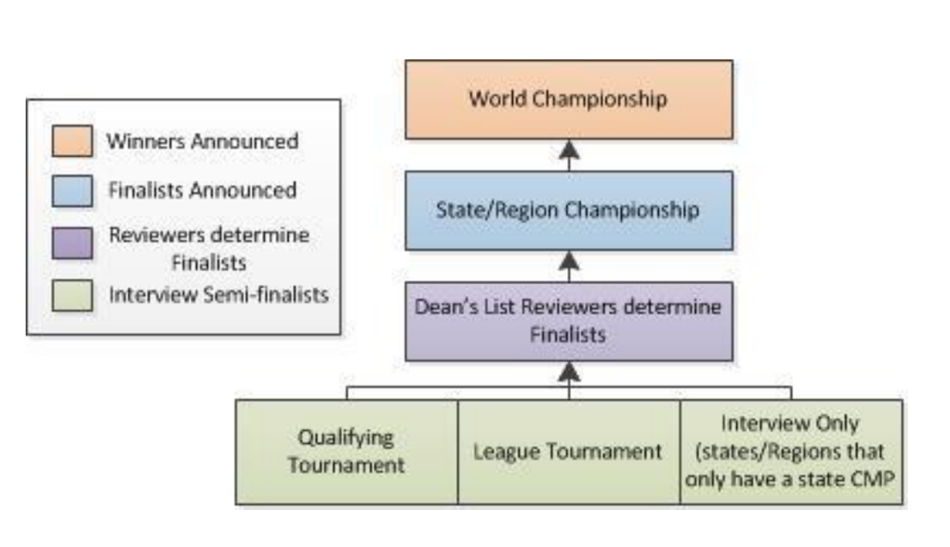
Dean’s List Award Selection
Three levels of achievement:
Semi-Finalist
Finalist
Winner
Who is eligible? • Current FTC participants who are Sophomores or Juniors
How selective is it? • 10 Winners from approximately 30,000 - 35,000 eligible FTC participants (out of 70,000 total)

Slide 5
What is the Dean’s List Award
What does a Winner receive?
Trip to FIRST HQ for Summit
Letter of Recommendation from Dean Kamen (Founder of FIRST)
Attention of colleges
Trophy, plus of goodies and swag
Things that Winners do not receive:
Automatic admission to highly selective colleges and universities
Full-ride scholarship (or any scholarship)

Slide 6
Dean’s List Semi-Finalist
Each registered team may submit up to two nominations
Coach/Mentor must submit nomination essay/letter online via FIRST Dashboard system
The team’s nominees automatically are considered Dean’s List Award Semi- Finalists

Slide 7
Dean’s List Finalists
All Semi-Finalists are interviewed at their League Finals competition to determine if they are Dean’s List Finalists
Depends on region (some regions have interviews at regional championship and some regions do not have interviews)
209 FTC Dean’s List Award Finalists worldwide • 165 from North America • 44 from outside of North America (i.e., “international”)

Slide 8
Dean’s List Winners
Each region submits its Finalists along with a brief summary from the Judges (which may add, amplify or correct information)
Winners are selected solely on the basis of the nomination essay and the Judges' summary
Total of 20 Winners worldwide
• 10 for FTC • 10 for FRC
Winner are “True ambassadors of FIRST”
They are “leaders who participate in fundraising, outreach, and spreading the word about FIRST; all the while excelling in school and other extracurricular endeavors”

Slide 9
Award Criteria
Be sure to download and carefully read the Dean’s List Award Nomination Guide – North America
Typically, this is issued/updated for the current season at the end of September or beginning of October
https://www.firstinspires.org/sites/default/files/uploads/resource_library/ftc/dean's-list-nomination-guide-us.pdf
Interviewer Guide
https://www.firstinspires.org/sites/default/files/uploads/resource_library/ftc/dean's-list-interviewer-and-reviewer-manual.pdf

Slide 10
What to Include in the Essay
How are they a leader?
How have they helped increase the awareness of FIRST?
Describe the student’s interest and passion that demonstrates their long-term commitment to FIRST.
Describe their technical expertise.
Describe their entrepreneurship and creativity
What are the student’s individual contributions to outreach or
fundraising efforts?
What are the student’s individual contributions to the Team, whether it is building, programming, team captain, etc.?
It is not necessary to include the student’s activities outside of FIRST; focus on FIRST related activities.

Slide 11
Nomination Essay Strategies
Tell a compelling story
It helps if, after reading the essay, the Reviewer feels he/she knows the candidate personally
Have a thesis (central concept)
Try to find unifying aspect of the candidate and return to it
Hit all criteria
Include specific examples, as well as metrics, especially for outreach and volunteering
Keep your focus on things related to FIRST - At least 75%
Mention things that are related to STEM/STEAM/CTE (10-15%)
Mention other outstanding achievements (but especially when there is a connection to or integration with FIRST (e.g., volunteer award) (5-10%)

Slide 12
Additional Suggestions
Ask candidates to submit a summary of achievements
Shows initiative and interest
Helps you learn things you might not know
Develop a metric to rank candidates, hold interviews and/or hold a team vote
Stay factual and evidential, but don't be afraid to make broad statements about the nominee, too

Slide 13
Interview Tips
Primary basis for selection is the nomination essay; the interview is meant to “meet the candidate” and potentially learn additional information... Relax!
You do not need to dress up; whatever you are wearing to competition (e.g., you team T-shirt or uniform) should be fine
However, it is like a job interview; be engaging and confident
You don’t need to memorize a speech or specific things to say
However, it makes sense to prepare “talking points” so you can remember things you want to tell the Reviewers in response to questions
Organize accomplishments into areas like “leadership,” “outreach,” “technical skills,” etc.
Do mock interviews

Slide 14
Credits
This lesson was written by Scot Duncan
You can contact the author at: pposton@firstinspires.org
More lessons for FIRST Tech Challenge are available at www.FTCtutorials.com
Image Credit: 6024 Enterprisers, 5326 Enterprisers, 11574 Sonic Screwdrivers
This work is licensed under a
Creative Commons Attribution-NonCommercial-ShareAlike 4.0 International License.

